Slide 1
TeamOne
Members
- Jay Turakhia
- Shlok Gandhi
- Chirayu Desai

Slide 2
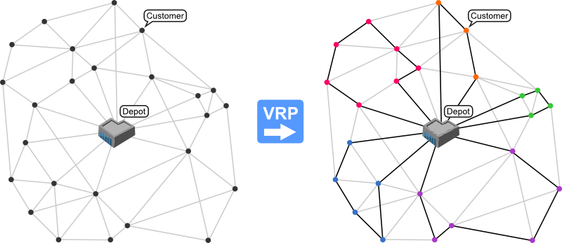
Vehicle Routing Problem
Image Source - http://neo.lcc.uma.es/vrp/vehicle-routing-problem/
Notes:
“Variables” ( several depots, dispersed cities /customers, vehicle fleet / delivery executives)

Slide 3
(Capacitated) Vehicle Routing Problem
CVRP
The objective - To deliver a set of customers with known demands on minimum-cost vehicle routes originating and terminating at a depot.
Notes:
“Variables” ( several depots, dispersed cities /customers, vehicle fleet / delivery executives)

Slide 4
CVRP
Practical scenarios kept in mind
Finite set of customers
No restriction on number of trucks
Capacity restricted to avoid the following situation

Slide 5
Solutions
Heuristics
Savings: Clark and Wright
2-Phase (Cluster first, solve later)
Sweep (Cluster)
TSP (solution)
Meta Heuristics
Genetic Algorithm
Improvements expected

Slide 6
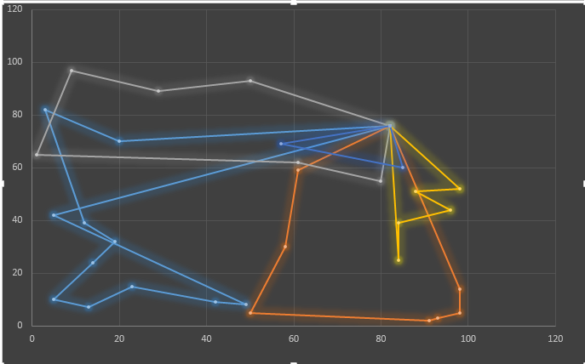
Improved Savings
Depot
Customers
Generate savings pairs
Measure of distance points saved by pairing two arbitrary customers in a route
Rank in reverse order
Start with the first savings pair
Iterate and fit to trucks as per capacity
Source : http://ieeexplore.ieee.org/document/7784340

Slide 7
2-phase – Cluster-first , Route-Second
Sweep Algorithm to cluster
Radially group customers and form clusters as per capacity with center as depot
Multiple approaches possible
Our implementation. Clockwise + Euclidean distance
Apply these customers’ clusters to TSP (Google OR tools)
Generate routes

Slide 8
PROPOSED PLAN OF ACTION
Jay – Designing the heuristic function
Shlok – Modifying the Genetic Algorithm so that it suits our case
Chirayu – Work on constraints and the optimized values required for the problem

Slide 9
Genetic Algorithms Approach 1

Slide 10
References
http://www.orcomplete.com/computer/sertalpbilal/solving-vehicle-routing-problem
http://neo.lcc.uma.es/vrp/vehicle-routing-problem/
http://www.jstor.org/stable/2627477?origin=JSTOR-pdf
G. Clarke and J. Wright “Scheduling of vehicles from a central depot to a number of delivery points”, Operations Research, 12 #4, 568-581, 1964.
M. L. Fisher and R. Jaikumar. “A Generalized Assignment Heuristic for Vehicle Routing”. Networks, 11:109-124, 1981.

